Slide 1

Hand Hygiene

Slide 2
What are germs?
Pathogens
Things like bacteria and viruses
Can cause infection and illness

Slide 3
Why might your hands look clean but still be dirty?

Slide 4
What are germs?
Pathogens
Things like bacteria and viruses
Can cause infection and illness
Microscopic- extremely small!

Slide 5
Discuss
How do your hands get dirty?
What are some high-touch surfaces?

Slide 6
What do germs cause in my body?
Diseases
Infection
Discomfort

Slide 7
22,000,000
Days are missed per year because of a common cold

Slide 8
Why should I wash my hands?
Hand hygiene has been proven as the single most effective way to prevent the spread of disease.

Slide 9
Finger
Palm
Thumb
Wrist

Slide 10
How to wash your hands
01
02
03
04
05
06
07
08
09
Wet your hands with water
Apply enough soap to your hands
Rub hands palm to palm with soap
Lather the backs of your hands
Scrub between your fingers
Rub back on opposite palms
Clean thumbs with enough soap
Wash your fingernails
Rinse hands with plenty of water

Slide 11
Practice
Time

Slide 12
01
02
03
04
05
06
07
08
09
Wet your hands with water
Apply enough soap to your hands
Rub hands palm to palm with soap
Lather the backs of your hands
Scrub between your fingers
Rub back on opposite palms
Clean thumbs with enough soap
Wash your fingernails
Rinse hands with plenty of water

Slide 13
Let’s put your handwashing skills to the test!

Slide 15
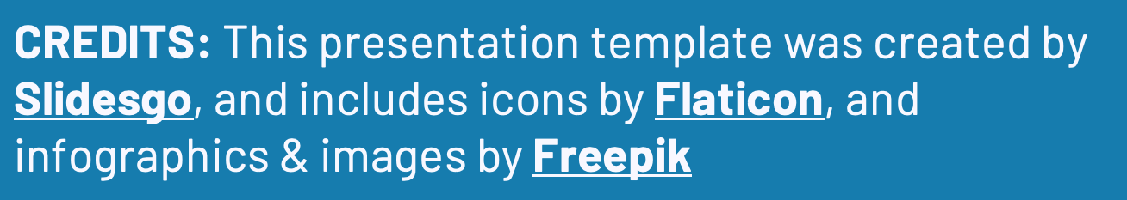
Thanks!
Any Questions?

